Slide 1
moose for dcs world AI A2A dispatcher

Slide 2
what is a2a dispatching?

Slide 3
build airborne defense system to counter air attacks
AIRBASE 1
AIRBASE 1
Attack
Defend
AIRBASE 2
AIRBASE 2
AIRBASE 3
AIRBASE 3

Slide 4
defend own border
AIRBASE 1
AIRBASE 1
BORDER
AIRBASE 2
AIRBASE 2
AIRBASE 3
AIRBASE 3

Slide 5

build your EWR (early warning radar) network
EWR
AIRBASE 1
AIRBASE 1
Attack
AIRBASE 2
AWACS
AIRBASE 2
EWR
AIRBASE 3
AIRBASE 3

Slide 6
setup squadrons at airbases
AIRBASE 1
AIRBASE 1
Squadrons
Name, Airbase, Templates, Resources
AIRBASE 2
AIRBASE 2
AIRBASE 3
AIRBASE 3

Slide 7
perform control air patrols (cap) in patrol zones
Control
Air Patrols
AIRBASE 1
AIRBASE 1
Attack
AIRBASE 2
Patrol Zones
AIRBASE 2
AIRBASE 3
AIRBASE 3

Slide 8
detect incoming attacks
Detect Intruders
AIRBASE 1
AIRBASE 1
AIRBASE 2
Group in Zones in defined radius
AIRBASE 2
AIRBASE 3
AIRBASE 3

Slide 9
engage attack
AIRBASE 1
AIRBASE 1
Engage all targets
AIRBASE 2
GCI where not enough CAP
AIRBASE 2
AIRBASE 3
AIRBASE 3

Slide 10
hot and cold war
AIRBASE 1
AIRBASE 1
Cold War
AIRBASE 2
AIRBASE 2
AIRBASE 3
AIRBASE 3
Hot War

Slide 11
(re-)engage airborne friendlies within the engage range
AIRBASE 1
Engage CAP Flight
AIRBASE 1
An “Engage Radius” around each detected target will engage any airborne friendlies capable for combat!
AIRBASE 2
Don’t Engage
Re-Engage Returning Incercept Flight
AIRBASE 2
AIRBASE 3
AIRBASE 3

Slide 12
squadron Overhead of defenses
AIRBASE 1
AIRBASE 1
AIRBASE 2
AIRBASE 2
AIRBASE 3
AIRBASE 3

Slide 13
squadron grouping of defenses
AIRBASE 1
AIRBASE 1
AIRBASE 2
AIRBASE 2
AIRBASE 3
AIRBASE 3

Slide 14
squadron takeoff
AIRBASE 1
AIRBASE 1
Takeoff methods
In the air
At the runway
From Cold Parking
From Hot Parking
AIRBASE 2
AIRBASE 2
AIRBASE 3
AIRBASE 3

Slide 15
squadron landing
AIRBASE 1
AIRBASE 1
Landing methods
Near the airbase
At the runway
After engine shutdown
AIRBASE 2
AIRBASE 2
AIRBASE 3
AIRBASE 3

Slide 16
setup your mission

Slide 17
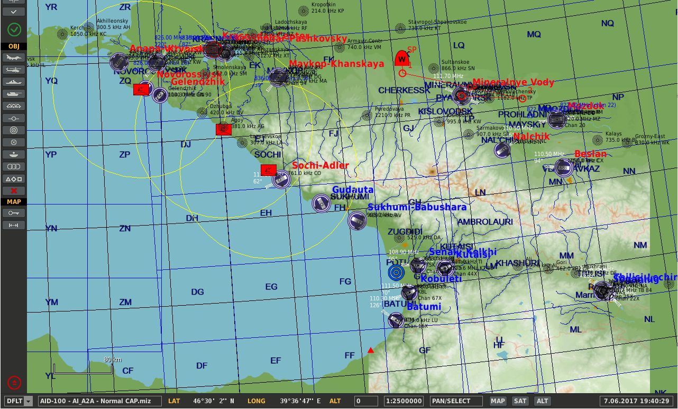
1. define your ewr network
AWACS
Create in the mission editor various objects with (long range) radars.
Typically EWR networks are setup using 55G6 EWR, 1L13 EWR, Hawk sr and Patriot str ground based radar units. These radars have different ranges and 55G6 EWR and 1L13 EWR radars are Eastern Bloc units (eg Russia, Ukraine, Georgia) while the Hawk and Patriot radars are Western (eg US).
Additionally, any other radar capable unit can be part of the EWR network! Also AWACS airborne units, planes, helicopters can help to detect targets, as long as they have radar.
DF CCCP EWR #003
DF CCCP AWACS #001
DF CCCP EWR #002
Long Range EWR units
DF CCCP EWR #001
The position of these units is very important as they need to provide enough coverage to pick up enemy aircraft as they approach so that CAP and GCI flights can be tasked to intercept them.
Additionally in a hot war situation where the border is no longer respected the placement of radars has a big effect on how fast the war escalates.

Slide 18
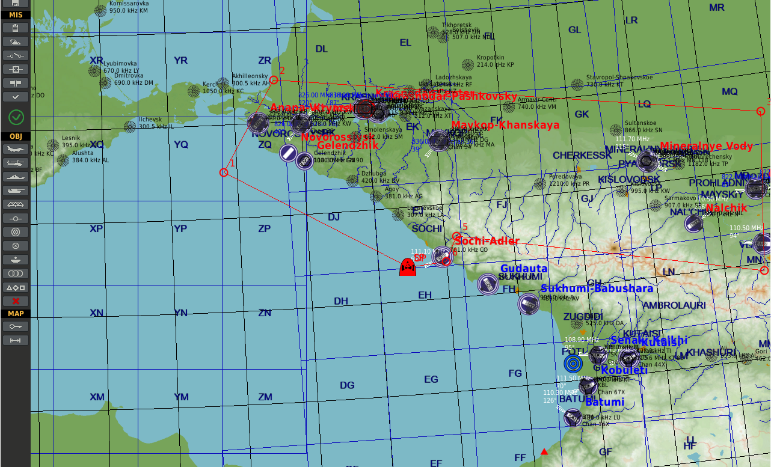
2. define your border zone
AWACS
Create in the mission editor, using a helicopter object (because helos don’t need valid ground) a route that defines the border zone of your A2A dispatcher object. Ensure that the zone does not include too many waypoints, but somehow follows the border.
The border may different according the tactical situation or mission design.
Giver the helicopter group a name that will be used in the script, and make it late activated. In this example it is “CCCP Border”.
Once the border has been defined, the helicopter object can be hidden.
DF CCCP EWR #003
DF CCCP AWACS #001 #001
DF CCCP EWR #002
Waypoints defining the border area!
Long Range EWR units
DF CCCP EWR #001
CCCP Border
Late Activated Helicopter Object

Slide 19
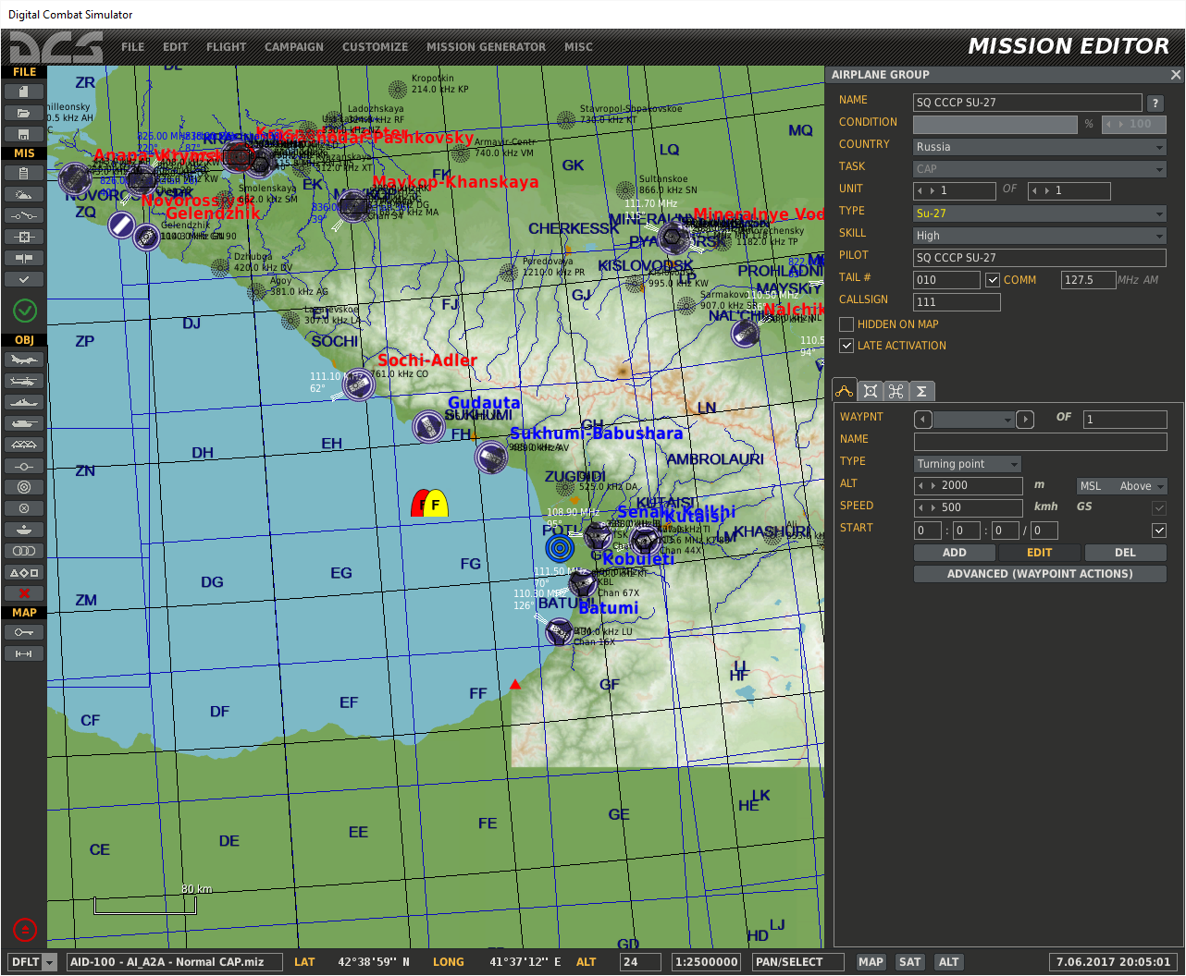
3. define your plane templates for cap and gci in service at squadrons
Create in the mission editor the templates of the planes that define your defenses. Those will be the planes that will be used by your squadrons located at defined airbases of your choice.
Each plane template will include a variation of plane type, Tail #, Callsign, Comms, Skin Setting and (Weapon) Loadout.
Each plane template MUST be a Group of EXACTLY ONE plane.
The Group name of each plane template will be used further in the scripting. In this example “SQ CCCP SU-27” and “SQ CCCP MIG-31”.
SQ CCCP SU-27
SQ CCCP MIG-31
Late Activated Plane Templates for CAP and GCI

Slide 20
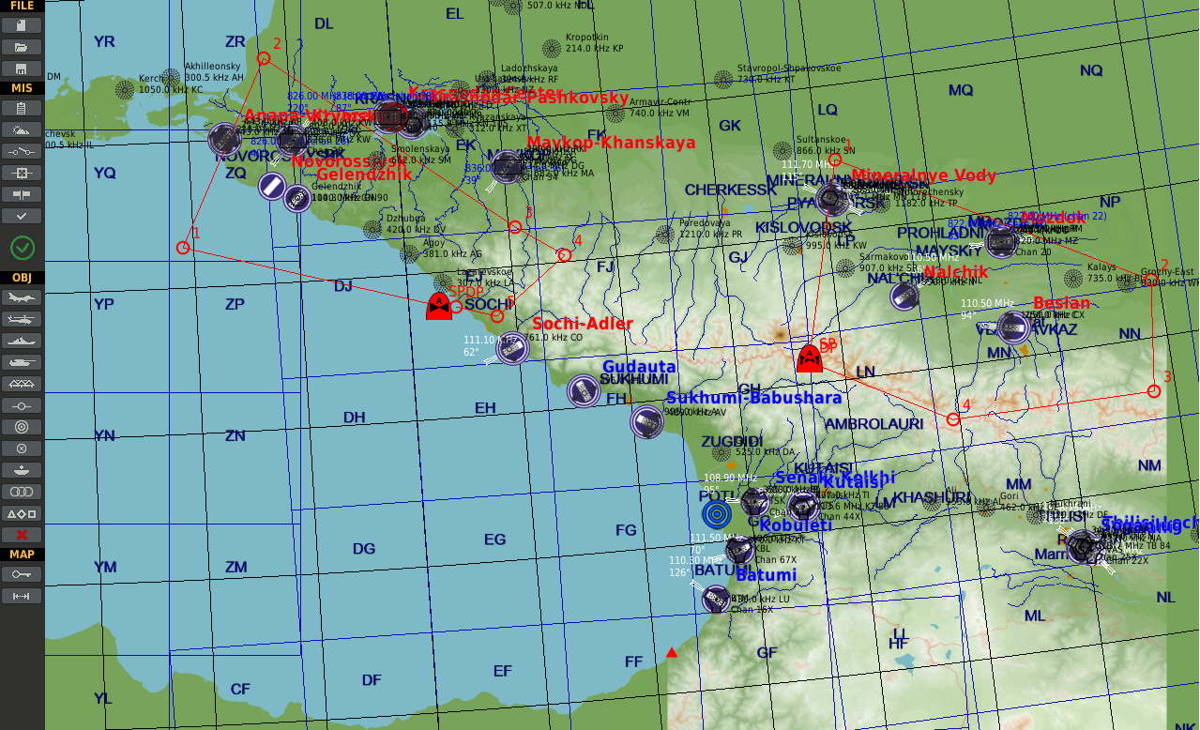
4a. Define your cap zones using polygons
Create in the mission editor, using a helicopter object (because helos don’t need valid ground) a route that defines a CAP zone of your A2A dispatcher object. Ensure that the zone does not include too many waypoints.
When you create zones with Helicopter objects, you are creating a ZONE_POLYGON zone object.
Give the helicopter groups a name that will be used in the script, and make it late activated. In this example it is “CAP Zone West” and “CAP Zone East”.
Once the border has been defined, the helicopter object can be hidden.
CAP Zone West
Late Activated Helicopter Objects
CAP Zone East

Slide 21
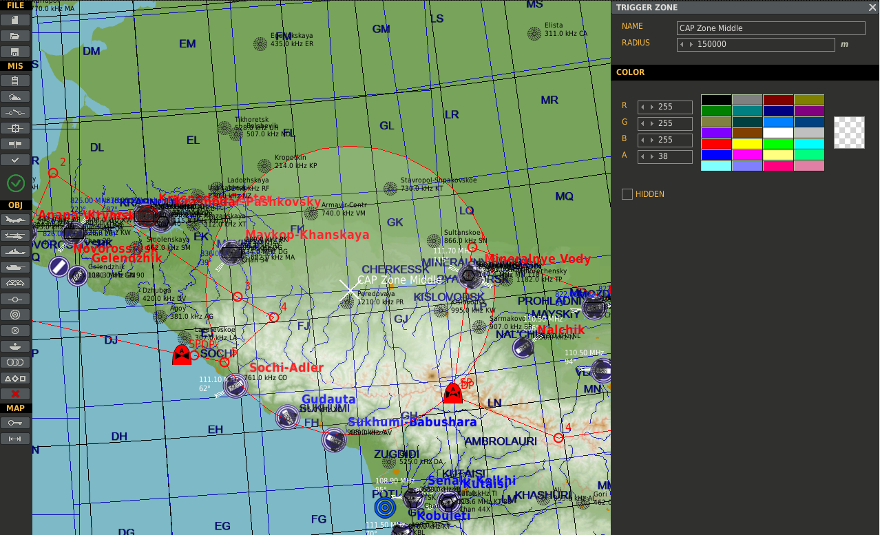
4b. Define your cap zones using trigger zones
CAP Zone Middle
Create in the mission editor, a trigger zone that defines a CAP zone of your squadron.
The border may different according the tactical situation or mission design.
Giver the trigger zone a name that will be used in the script. In this example it is “CAP Zone Middle”.
Once the border has been defined, the trigger zone can be hidden.
Trigger
Zone
CAP Zone West
Late Activated Helicopter Objects
CAP Zone East

Slide 22
“script it”

Slide 23
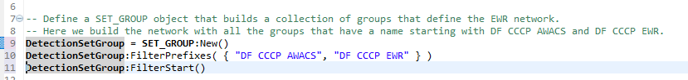
5. “script” the ewr network
Line 9: Create a new SET_GROUP object called “DetectionSetGroup”, which is a set of Groups.
Line 10: Let DetectionSetGroup include all Groups that start with the name DF CCCP AWACS or DF CCCP EWR.
Line 11: Include all Groups with those names into the set.
DF CCCP EWR #003
DF CCCP AWACS #001
DF CCCP EWR #002
DF CCCP EWR #001
LUA Script

Slide 24
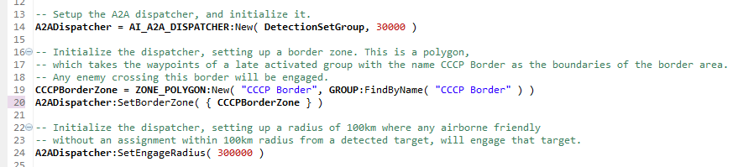
6. “script” the ai a2a dispatcher object and configure it
LUA Script
Line 14: Create the A2ADispatcher object from the AI_A2A_DISPATCHER class, providing the DetectionSetGroup object as the first parameter, and setting a radius of 6000 meters to group the detected targets!
Line 19: Create the Border Zone. This is a Polygon Zone with the Group name “CCCP Border”, and create a CCCPBorderZone object.
Line 20: Set the Border Zone at the A2ADispatcher object using the method InitBorderZone, providing the CCCPBorderZone object.
CCCP Border
Line 24: Set the “Engage Radius”, which is the radius in which any friendly unit within 100km from the detected target will be (re-) engaged when that friendly has no duties or current task, like RTB.

Slide 25
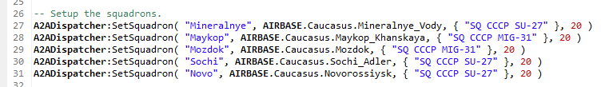
7. “script” the squadrons and compositions
LUA Script
:SetSquadron takes 4 parameters: 1. The Name of the Squadron. This is the key of the squadron and must be unique! 2. The Airbase at which the Squadron is located. Use the AIRBASE enumerator for this. 3. The list ( between { } ) of templates defined as strings. 4. The amount of resources.
SQ CCCP SU-27
SQ CCCP MIG-31

Slide 26
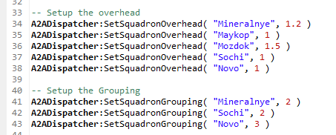
7. “script” the squadrons and compositions
LUA Script
:SetSquadronGrouping takes 2 parameters: 1. The Name of the Squadron. This is the key of the squadron and must be unique! 2. The grouping parameter specifies how many units will form one group.
:SetSquadronOverhead takes 2 parameters: 1. The Name of the Squadron. This is the key of the squadron and must be unique! 2. Overhead parameter, which is a number. 1 is neutral, bigger than one is more defenses, lower than 1 is less defenses.
SQ CCCP SU-27
SQ CCCP MIG-31

Slide 27
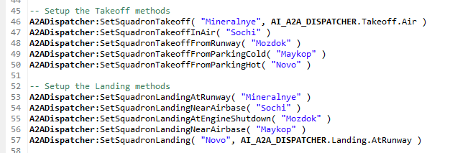
7. “script” the squadrons and compositions
LUA Script
:SetSquadronTakeoff and :SetSquadronTakeoff specify the takeoff and landing methods applied to resolve bottlenecks at airports or to increase realism.
SQ CCCP SU-27
SQ CCCP MIG-31

Slide 28
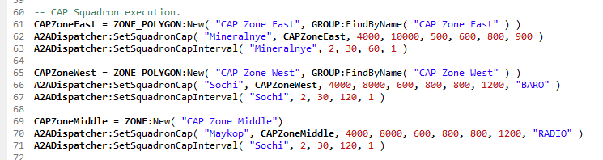
8. “script” the cap operations per squadron using polygon zones
LUA Script
CAP Zone West
CAP Zone East
Line 61 and 65: Setup a new ZONE_POLYGON objects using the Late Activated helicopter group waypoints of “CAP Zone West” and “CAP Zone East”.
Line 62 and 66: Assign CAP operations to the Squadrons “Mineralnye” and “Sochi”, using the zones CAPZoneEast and CAPZoneWest. Set min/max altitude to 4000/8000 meters, and min/max speed to 600/800 km/h.
Line 62: No altitude type is given. The default is barometric (“BARO”).
Line 66: Define a barometric altitude measurement ( “BARO” ).

Slide 29
8. “script” the cap operations per squadron using trigger zones
CAP Zone Middle
LUA Script
Line 70: Assign CAP operations to the Squadron “Maykop”, using the trigger zones CAPZoneMiddle. Set min/max altitude to 4000/8000 meters, and min/max speed to 600/800 km/h.
Line 70: Define a radio altitude measurement ( “RADIO” ).
Line 69: Setup a new ZONE object using the trigger zone definition “CAP Zone Middle”.

Slide 30
8. “script” the cap operations per squadron using trigger zones
CAP Zone Middle
LUA Script
Line 63, 67 and 71: Specify how many cap groups can be active at the same time for the squadron, and the minimum and maximum interval for the CAP.

Slide 31
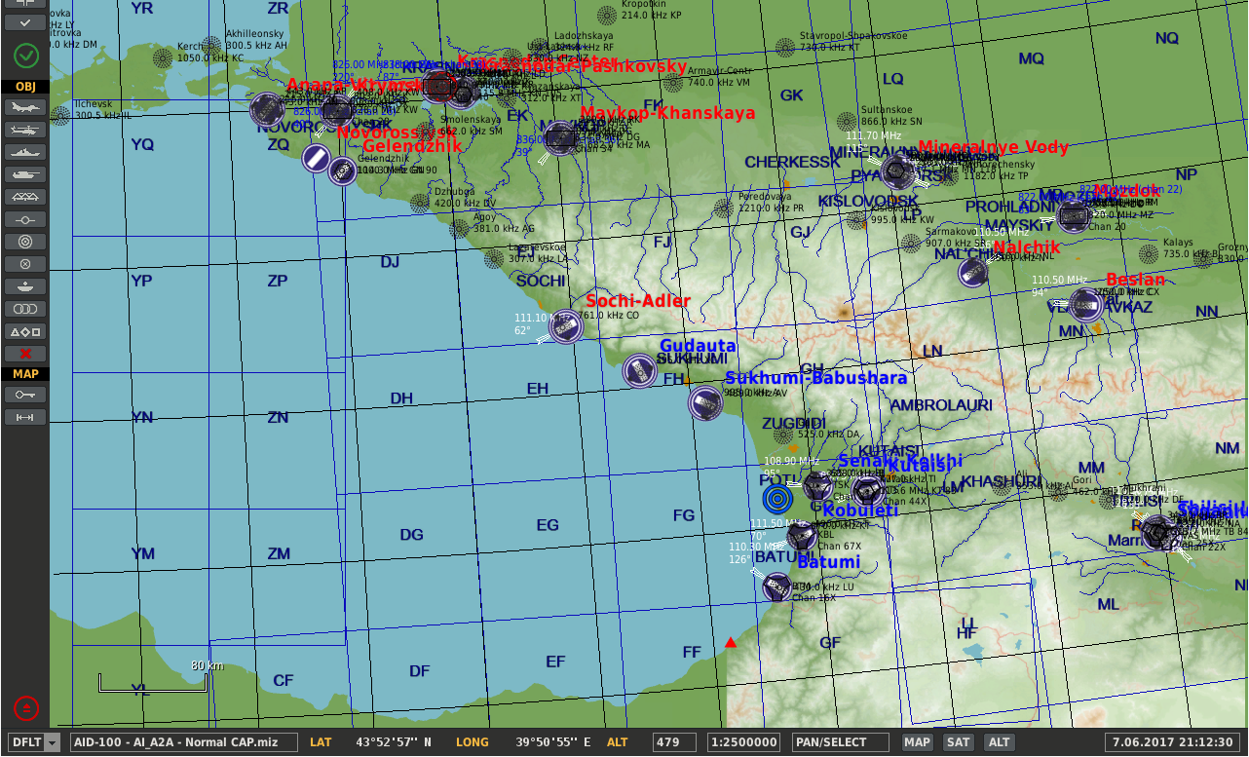
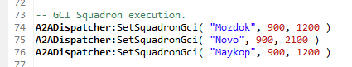
5. “script” the gci squadron operations.
Line 74 till 76: Setup a GCI operation for the Squadron Name. During intercept, set a min/max speed of 900/1200 km/h.
LUA Script

Slide 32
moose for dcs world AI A2A GCICAP – Tutorial 6

Slide 33
intercept point

Slide 34
intercept point calculation
AIRBASE 1
AIRBASE 1
AIRBASE 2
AIRBASE 2
INTERCEPT POINT
AIRBASE 3
AIRBASE 3

Slide 35
moose for dcs world AI A2A GCICAP – Tutorial 7

Slide 36
disengage radius

Slide 37
disengage radius
AIRBASE 1
AIRBASE 1
AIRBASE 2
AIRBASE 2
INTERCEPT POINT
AIRBASE 3
AIRBASE 3

Slide 38
moose for dcs world AI A2A GCICAP – Tutorial 8

Slide 39
cap and refuelling

Slide 40

refuel defenders in mid air at specified tankers
Default Tanker
Default Fuel Threshold
AIRBASE 1
Default Tanker
SQ1
SQ1
Squadron Fuel Threshold
SQ2 Tanker
AIRBASE 2
SQ2
Squadron
Tanker
AIRBASE 3
SQ2

Slide 41
moose for dcs world AI A2A GCICAP – Tutorial 9

Slide 42
CAP and Early warning

Slide 43
(re-)engage airborne friendlies within the engage range
AIRBASE 1
Engage CAP Flight
AIRBASE 1
An “Engage Radius” around each detected target will engage any airborne friendlies capable for combat!
AIRBASE 2
Don’t Engage
Re-Engage Returning Incercept Flight
AIRBASE 2
AIRBASE 3
AIRBASE 3

Slide 44
CAP also detect targets
AIRBASE 1
Detection
AIRBASE 1
AIRBASE 2
No Detection
AIRBASE 2
AIRBASE 3
AIRBASE 3

Slide 45
CAP also detect targets
AIRBASE 1
Continue Patrol
AIRBASE 1
AIRBASE 2
Closest will engage!
AIRBASE 2
AIRBASE 3
AIRBASE 3

